Slide 1

Transportation
Jim Foley
Director

Slide 2
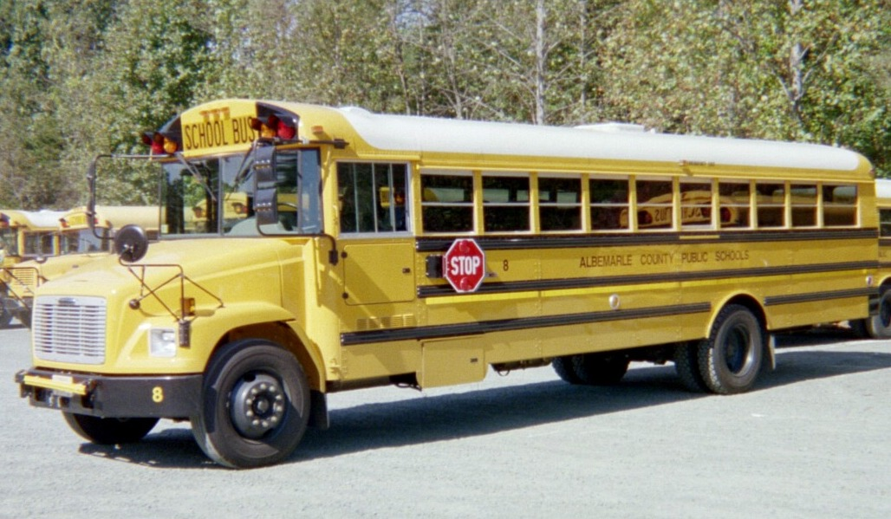
Thank You
For supporting school bus replacement!

Slide 3
Programs and Services
Home to school transportation
Special needs transportation
Athletic trips, field trips
Maintenance for education and government vehicles
Planning and analysis
Training
County vehicle fuel administration
Inclement weather road assessment

Slide 4
Philosophy
Engagement
Accountability
Seek input
Transparency
Customer service
Fiscal responsibility

Slide 5
Successes
On-time arrival
  98.1% LY
  98.1% YTD
  99.1% Nov and Dec
  15/26
6.4 sigma safe driving
LTA (lost time accident) reduction
Answer every parent/citizen call/email

Slide 6
Successes
Misplaced student risk reduction
Thorough performance evaluations
Fleet management
Redistricting data supply
Mainstreaming SPED students
SSHS and HR partnerships

Slide 7
Challenges
Retention – 9% annual non-retirement voluntary turnover YTD
Student behavior management
Ridership
Preventable fender-benders
30% of county vehicles are not serviced at VMF

Slide 8
Budget
Have reduced operating costs 12% since 08/09
Budget is 82% labor and 12% net fuel ($8.3million of $8.8 million total)
Wage increases have totaled over 8% last three years
PAQ increased most employees’ wages
Driver labor is largest variable cost
All non-exempts paid to the minute (iPods)

Slide 9
Budget
Have requested extra staff hours through initiatives
Will only use if needed and will continue to control costs

Slide 10
Initiatives
Two (“Additional Staff Hours” and “CDL-Holder Training”) are designed to address previously unbudgeted OT for training and growth
“Mandt, First Aid, and CPR Training” provides for improved service through training

Slide 11
Future
Alternative Fuel - CNG
Cross Arm Cameras – started pilot
Student Behavior – align with Responsive Classroom and Restorative Practices

